Slide 1
Prometheus Query Language

Slide 2
Powerful Query Language of Prometheus Provides built in operators and functions Vector-based calculations like Excel Expressions over time-series vectors
Prometheus
Application A
Scrape every 15 sec
Get/actuator/prometheus

Slide 3
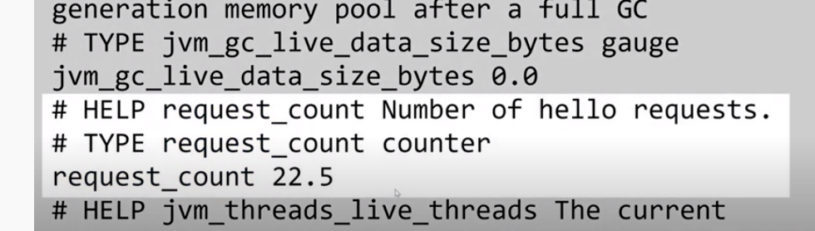
4 Types of Prometheus Metrics
1. Counters- Value that increases
Use Cases for Counters :- Request Count , Error Count
Java Client Library exposes - Counter class which exposes methods such as builder and methods to increment the counter by 1 and method to increment any specific value to double value.
How does Prometheus expose counters ?
- http://localhost:9000/actuator/prometheus
How can we query in Prometheus ?
Rate (request_count[5m] )

Slide 4
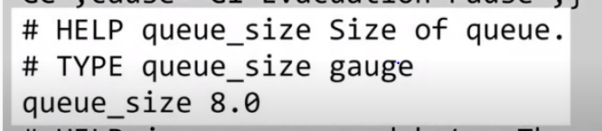
4 Types of Prometheus Metrics
2. Gauges- Values that Go down and Up
Use Cases :-Memory Usage, No. of Items in the queue.
Java Client Library exposes - Gauge class which exposes the following methods :- builder methods and methods to increment the counter by 1 ,double value, decrement the value, method to set the metric .
How does Prometheus expose counters ?
http://localhost:9000/actuator/prometheus
Avg_over_time(queue_size [5m])

Slide 5
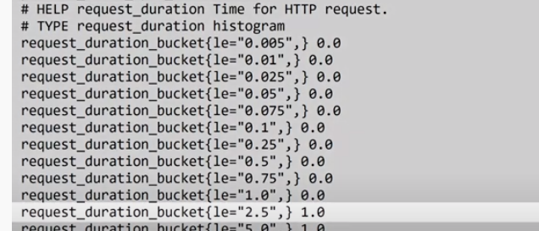
4 Types of Prometheus Metrics
3. Histogram- Values that fall into specific pre-defined buckets
For Eg :- Request duration for specific request code, Response size
Store value with the approx. that fall under these buckets.
Java Client Library exposes - Histogram class which exposes - Builder methods and bucket method to define your custom bucket , start Timer method, observe duration method.
Prometheus exposes - http://localhost:9000/actuator/prometheus
Avg Request duration for the last 5 min – rate (request_duration_sum[5m])
rate (request_duration_count[5m])
95th Percentiles for the last 5 min- histogram_quantile(.95, sum(rate(request_duration_bucket[5m])) by (le))

Slide 6
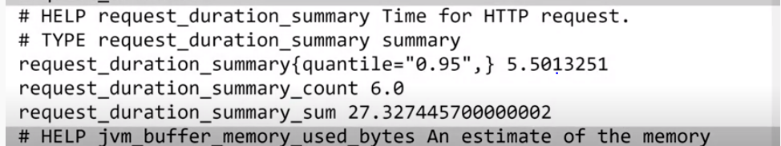
4 Types of Prometheus Metrics
4. Summary - Values that fall into specific pre-defined buckets
Request duration for specific request code, Response size
Java Client Library exposes - Summary class which exposes builder method, quantile methods, start Timer method, observe duration method and observe method.
Prometheus exposes - http://localhost:9000/actuator/prometheus
Avg Request duration for the last 5 min – rate (request_duration_summary_sum[5m])
rate (request_duration_summary_count[5m])
95th Percentiles -request_duration_summary{quantile=“0.95”}

Slide 7
Prometheus Querying
Metric_name- http_requests_total
Labels- simply key-value pairs- http_requests_total{job="prometheus", code="200"}
Value- which is float64. Value shown is the value for the most recent timestamp
Timestamp- Millisecond precision

Slide 8
Data Types
Metric_name & label combination is called a time-series
Collection of series returned from a query is called an instant-vector
http_request_count
Series has multiple values, it is referred to as a range-vector
http_request_count[5m]
use (s, m, h, d, w, y) to represent (seconds, minutes, hours, ...)
Range-vectors can’t be graphed because they have multiple values for each timestamp

Slide 9
Labels Distinguishing different metrics
Label filters support four operators:
= equal
!= not-equal
=~ matches regex
!~ doesn’t match regex
Regex-matching
http_requests_total{status_code=~"2.*" ,namespace!~".*env4.*"}

Slide 10
Functions
Range-vector is typically generated in order to then apply a function to it to get an instant-vector, which can be graphed (only instant vectors can be graphed)
Rate - increase-of-http_requests_total-averaged-over-the-last-5-minutes
rate(http_requests_total[5m])
Irate- Looks at the 2 most recent samples (up to 5 minutes in the past),
irate(http_requests_total[5m])
increase - calculates the increase in the time series per the time range selected.
increase(http_requests_total[1h])

Slide 11
Offset - comparing current usage to past usage
sum(rate(http_requests_total[5m] offset 5m))
List of Functions
https://prometheus.io/docs/prometheus/latest/querying/functions/

Slide 12
Joining Series
Series can be combined in Prometheus by using an operator on them.
Arithmetic (+, -, *, /, %, ^),
useful for calculating ratios & percentages.
varnish_main_client_req{namespace="section-9469f9cc28d8d"} * 10
Comparison (==, !=, >, <, >=, <=) and Logical (and, or, unless) operators that can be applied to multiple series .
Label Matching – on and ignoring Keyword.
varnish_main_client_req{namespace="section-9469f9cc28d8d",pod="varnish-786d4648bd-rfnjb”} + on (namespace) varnish_main_client_req{namespace="section-9469f9cc28d8d",pod="varnish-786d4648bd-lpgf”}

Slide 13
One-to-one - finds unique pair of entries with all labels matching
Many-to-one / One-to-many - where each element on a “one” side can multiple elements on the “many” side – group_left v group_right determines cardinality – only used for comparison and arithmetic operations
Aggregation operators
Self-explanatory sum, min, max, and avg
sum(varnish_main_client_req{namespace="section-9469f9cc28d8d"}) by (namespace)

Slide 14
CPU-usage-by-instance
Average CPU Usage per instance for a 5 minute window.
100 * (1 - avg by(instance)(irate(node_cpu{mode='idle'}[5m])))
Percentage of memory being used by instance.
node_memory_Active / on (instance) node_memory_MemTotal

